Slide 1
x86 Processor Architecture
TEXT2 (2.2-2.5)

Slide 2
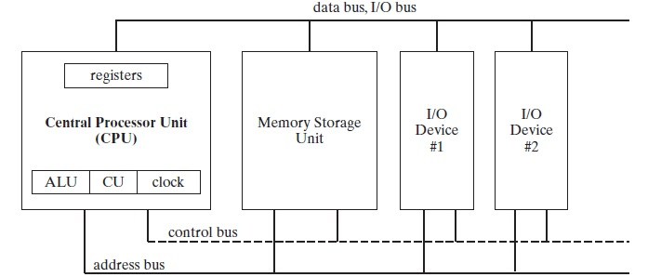
General microprocessor overview

Slide 3

The Clock
Each operation involving the CPU and the system bus is synchronized by an internal clock pulsing at a constant rate.
The basic unit of time for machine instructions is a machine cycle (or clock cycle ).
The speed of oscillation of the clock is usually quoted per processor.
A 1GHz processor has a clock that oscillates 1 billion times per second.
The duration of a clock cycle is calculated as the reciprocal of the clock’s speed. (1ns for a 1GHz clock)

Slide 4
x86 Processors
x86 processors have three primary modes of operation:
Protected Mode
Protected mode is the native state of the processor, in which all instructions and features are available.
Real-Address Mode
Real-address mode implements the programming environment of the Intel 8086 processor with a few extra features.
System Management Mode
provides an operating system with a mechanism for implementing functions such as power management and system security.

Slide 5
Basic x86 Program Registers
Registers are high-speed storage locations directly inside the CPU, designed to be accessed at much higher speed than conventional memory.
The general-purpose registers are primarily used for arithmetic and data movement.
Portions of some registers can be addressed as lower 16-bit or 8-bit values.
For example, the EAX register has a lower 16-bit AX part, while the AX register, has an 8-bit upper half named AH and an 8-bit lower half named AL.

Slide 6
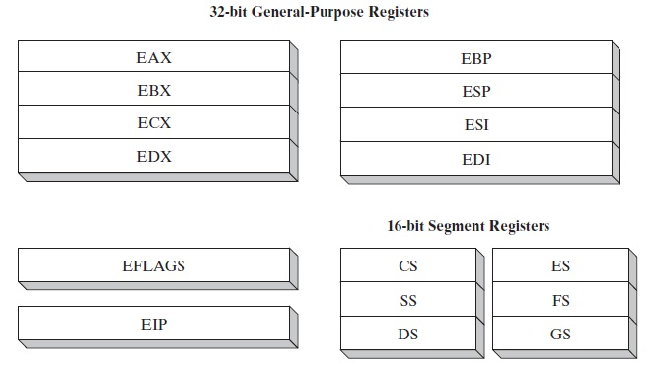
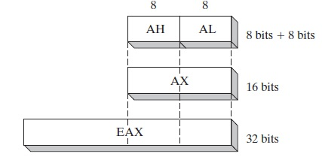

Slide 7
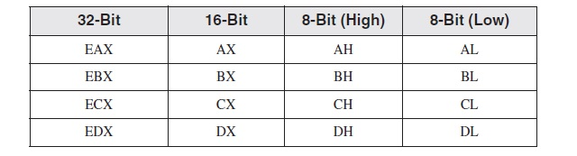
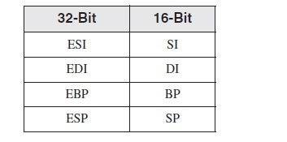
All ..X general purpose registers can be expressed in the same formats shown for EAX previously.
The remaining general-purpose registers can only be accessed using 32-bit or 16-bit names

Slide 8
Special-purpose general-purpose registers
EAX: Used for multiplication and division instructions.
ECX: Used by the CPU as a counter in loop instructions (automatic)
ESP: Used to point to the stack
ESI and EDI: Used for high speed memory transfer instructions.
EBP: Points to a memory location on the stack. Usually used by high level languages.
The EIP: stores the address of the next instruction to be executed.

Slide 9
EFLAGS: They indicate the condition of the microprocessor and control its operation.
Status flags: reflect the outcomes of arithmetic and logical operations performed by the CPU.
Carry flag (CF): result is too large to fit into the destination (unsigned).
Overflow flag (OF): result is too large or too small to fit into the destination (signed).
Sign flag (SF): result is negative.
Zero flag (ZF): result is zero.
Auxiliary Carry flag (AC): a carry from bit 3 to bit 4 in an 8-bit operand.
The Parity flag (PF): the least-significant byte in the result contains an even number of 1 bits.

Slide 10
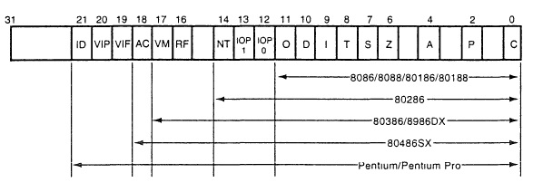
EFLAG register for x86 processors (up to Pentium)
Control Flags
I (Interrupt): controls interrupt request pin (INTR). If I=1 pin is enabled. If I=0, the pin is enabled. (Assembly: STI and CLI)
D (direction): Sets increment or decrement mode for DI and/or SI registers. D=1:automatic increment, D=2:automatic decrement. (Ass. STD and CLD)

Slide 11
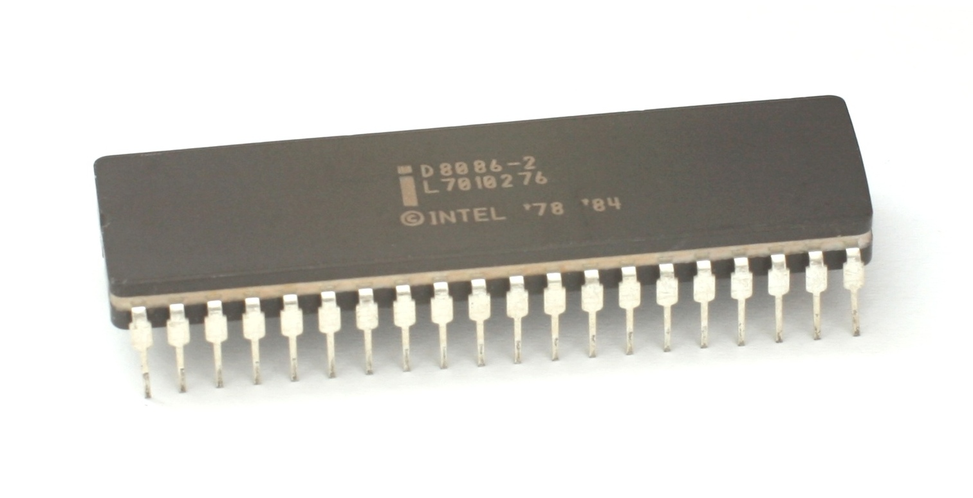
The Intel 8086

Slide 12
0
The Intel 8086 processor (1978) marked the beginning of the modern Intel architecture family.
Primary innovations: 16-bit registers, a 16-bit data bus and a segmented memory model permitting programs to address up to 1 MByte of RAM.
The original IBM PC contained the 8088, a slightly modified version of the 8086.
Backward Compatibility
Each processor introduced into the Intel family since the 8086 has been
backward-compatible with earlier processors.

Slide 13
Real Address Mode
In real-address mode, an x86 processor can access 1,048,576 bytes of memory (1 MByte) using 20-bit addresses in the range 00000H to FFFFFH.
Intel engineers had to solve a basic problem: the 8086 had 16 bit registers.
They came up with a scheme known as segmented memory. All of memory is divided into 64-kilobyte (64-KByte) units called segments.

Slide 14
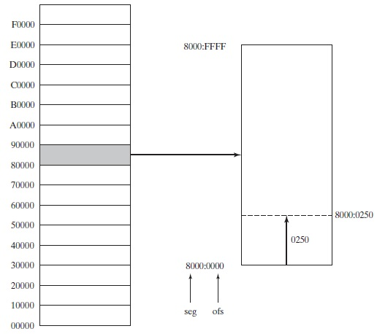
Each segment begins at an address having a zero for its last hexadecimal digit.
To specify a particular byte address, the base address of its segment, as well as an offset is needed.
Hence addresses are in the form- segment:offset
The actual address is referred to as the physical, linear or effective address.

Slide 15
The segment registers CS, DS, SS, ES, FS and GS are used for storing the base addresses of segments.
A typical program has three segments: code, data, and stack.
CS, DS and SS are used with these respectively.
ES, FS and GS may be used for ‘extra’ purposes.

Slide 16
Protected Mode
Protected mode is the more powerful “native” processor mode.
When running in protected mode, a program’s linear address space is 4 GBytes, using addresses 0 to FFFFFFFF hexadecimal.
The flat segmentation model is appropriate for protected mode programming in MASM.
In the flat segmentation model, all segments are mapped to the entire 32-bit physical address space of the computer.
Segment registers point to segment descriptor tables, which the operating system uses to keep track of locations of individual program segments.

Slide 17
Reminder
Download Visual Studio Express Edition for Assembly language programming.

